Slide 1
Fundamentals of Fog and Edge Computing
BCSE313L
WINTER 2024 - 2025
Module 2 - Challenges in Federating Edge Resources

Slide 2
Introduction – Key issues in Cloud-to-Things
Key Issues
Interoperability
Scale
Geographic Distribution
Heterogeneity
Constrained Resources
Real time Processing

Slide 3
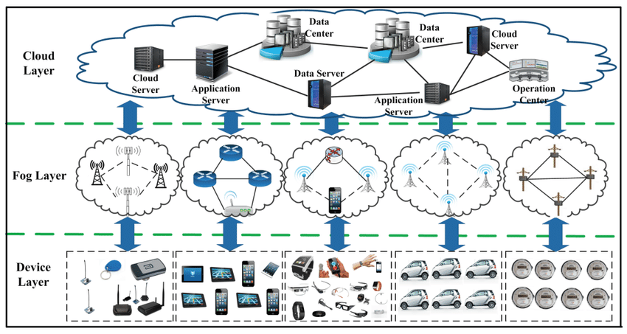
Federating Edge Resources - Introduction

Slide 4
Federating Edge Resources - Introduction
The process of connecting and sharing computing resources located at the edge of the network.
These resources can include servers, storage, and networking equipment.
By federating these resources, organizations can create a more distributed and scalable infrastructure that can better support applications and services that require low latency and high bandwidth

Slide 5
Federating Edge Resources - Introduction
Revisiting Edge of Network
The "edge of the network" refers to the boundary points where a computer network connects to other networks.
It's essentially where one network ends and another begins.

Slide 6
Federating Edge Resources - Introduction
Edge computing aims to improve application performance by decentralizing resources from cloud data centers to the network edge.
Current edge deployments are often ad hoc, private, and sporadically distributed, limiting their global impact.
A federated edge, connecting edge deployments across regions, is needed for global accessibility and computational fairness but faces technical, social, legal, and geopolitical challenges.

Slide 7
Federating Edge Resources - Challenges
Two key challenges for federated edge are networking and management.
The networking challenge involves creating a dynamic networking environment compatible with federated edge scenarios.
Software-defined networking (SDN) is a potential solution for orchestrating edge resources, but global coordination across SDN domains is required in a federated context.
Balancing local edge deployments with the federated infrastructure is critical, requiring a potential rethinking of the edge networking model and further development of SDN's east-west interface.

Slide 8
Federating Edge Resources - Challenges
Management challenges are crucial for seamless service delivery in large-scale edge computing infrastructures.
Current edge deployments assume service cloning or availability on alternate nodes, which is insufficient for federated edge scenarios.
Rapid service migration between nodes based on demand is needed but faces challenges due to high overhead and unsuitability for resource-constrained edge environments.
Key management issues include benchmarking, provisioning, discovery, scaling, and migration.

Slide 9
Federating Edge Resources - Challenges
Resource challenges exist at both hardware and software levels.
Hardware solutions are often application-specific, creating significant heterogeneity.
Software solutions designed for cloud data centers have high overheads.

Slide 10
Federating Edge Resources - Challenges
Modeling challenges arise from integrating the edge into the cloud ecosystem.
Simulators are needed to investigate the implications of large-scale edge deployments, but current understanding of user-edge-cloud interactions is limited.

Slide 11
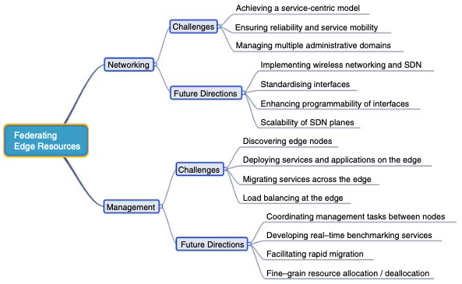
Federating Edge Resources - Challenges

Slide 12
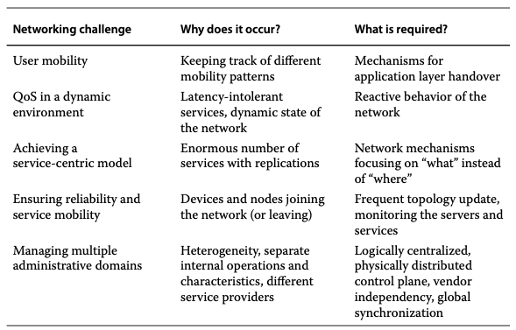
Federating Edge Resources - Challenges

Slide 13
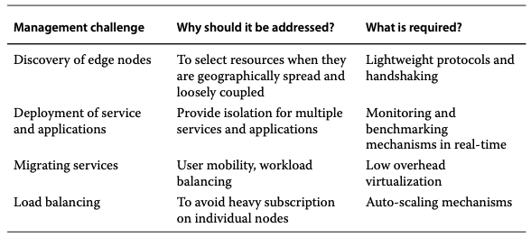
Federating Edge Resources - Challenges

Slide 14
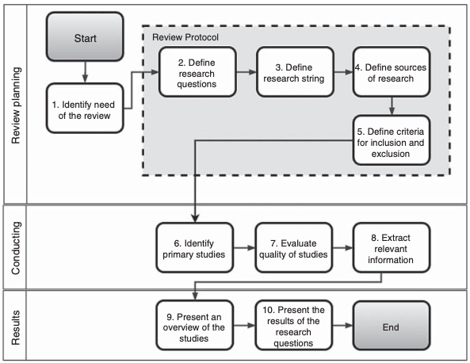
Federating Edge Resources – Review Methodology

Slide 15
Cloud-to-Fog-to-Internet of Things (C2F2T) – Analytical Model
Mathematical models that provide a closed-form solution, meaning the solution can be expressed as a mathematical function.
Used to predict resource requirements, assess workload behavior, and measure the impact of hardware/software changes.
Often rely on approximations, which must be carefully considered.

Slide 16
C2F2T – Analytical Model - Examples
Architecture Modeling
Gateway Modeling
Scheduling Mechanism
QoS Prediction
Defines an architecture with vectors of associated features for physical and virtual components, using equations to calculate metrics like power consumption and time latency.
Considers the number of gateways, data received, and processing time, proposing equations to represent buffer occupancy and delay.
Proposes an analytical model for scheduling in IoT environments, accounting for variables like processor load, memory, and bandwidth.
Presents a method to predict QoS of IoT services using a neighborhood collaborative filter and equations to predict latency, response time, and user network condition.

Slide 17
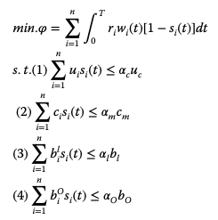
Cloud-to-Fog-to-Internet of Things (C2F2T) – Analytical Model 1
This model aims to manage sensor applications by a gateway, considering the resource requirements of these applications.
Equation mathematically represents the optimization problem formulated in the research

Slide 18
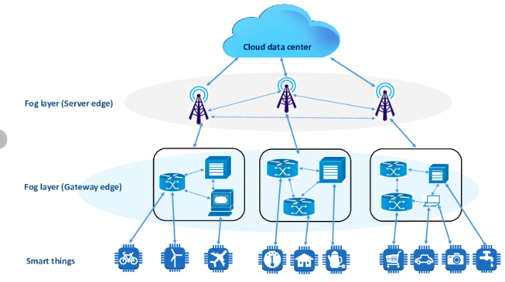
Cloud-to-Fog-to-Internet of Things (C2F2T) – Analytical Model 1

Slide 19
Cloud-to-Fog-to-Internet of Things (C2F2T) – Analytical Model 1
A: Set of n applications
a_{i}: Individual application, where i = 1, 2, ..., n
R_{i}: Resource requirement vector for application a_{i}
r_{i}: Priority of application a_{i}, ranging from 0 to 1
w_{i}(t): Required work status of application a_{i} at time t
s_{i}(t): Actual working status of application a_{i} at time t

Slide 20
Cloud-to-Fog-to-Internet of Things (C2F2T) – Analytical Model 1
n Applications:
Represented by the set A = {a1(Ri, r_{i}, w_{i}(t), s_{i}(t)), a2(R2, r₂, w₂(t), s₂(t)), ..., an(Rn, r_{n}, w_{n}(t), s_{n}(t))}
Each application (ai) is characterized by:
R_{i}: Resource requirement vector (specifies the resources needed by the application)
r_{i} ∈ [0, 1]: Priority of the application (a value between 0 and 1)
w_{i}(t): Required work status of the application at time 't'
s_{i}(t): Actual working status of the application at time 't'

Slide 21
Cloud-to-Fog-to-Internet of Things (C2F2T) – Analytical Model 1
Objective Function (min.φ):
The goal is to minimize the value of 'φ', which likely represents the total waiting time of all tasks (applications) being processed by the gateway.
The integral within the summation calculates the waiting time for each application over the evaluation time 'T'.

Slide 22
Cloud-to-Fog-to-Internet of Things (C2F2T) – Analytical Model 1
Constraints:
The equations below "s.t." represent constraints that must be satisfied during the scheduling process.
Constraint 1: Limits the total CPU utilization (u_{c}) to a certain threshold (α_{c}).
Constraint 2: Limits the total memory consumption (c_{m}) to a certain threshold (α_{m}).
Constraint 3: Limits the input bandwidth usage (b_{l}) to a certain threshold (α_{l}).
Constraint 4: Limits the output bandwidth usage (b_{o}) to a certain threshold (α_{o}).
α_{c}, α_{m}, α_{l}, α_{o}: These are overloading factors that indicate the extent to which the system can tolerate resource usage exceeding the ideal limits while still maintaining smooth operation.

Slide 23
Cloud-to-Fog-to-Internet of Things (C2F2T) – Analytical Model 1
Equation formulates an optimization problem where the objective is to minimize the total waiting time of sensor applications while ensuring that the gateway's resources (CPU, memory, bandwidth) are not overloaded.
The model considers factors like application
priorities,
resource requirements, and
desired work status to schedule applications efficiently.

Slide 24
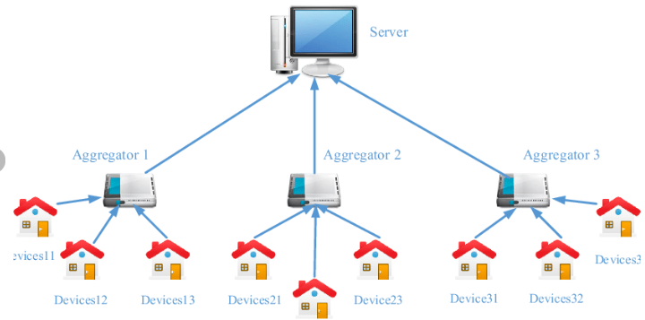
Cloud-to-Fog-to-Internet of Things (C2F2T) – Analytical Model 2
Functions of Aggregator
Data Collection
Data Processing and Analysis
Command and Control
Data Storage and Management
Communication Gateway

Slide 25

Cloud-to-Fog-to-Internet of Things (C2F2T) – Analytical Model 2
Analytic expressions for representing the expected energy consumption of devices and a cloud billing method for a group of devices on an IoT aggregator.
Computes the energy consumption of each device over the monitoring period, T

Slide 26
Cloud-to-Fog-to-Internet of Things (C2F2T) – Analytical Model 2
expected energy consumption of devices takes into account:
Query data volume of devices (E[Ψ_{e}]) - it's the average amount of data that devices send or receive in a given time period.
Consumption rate (lg_{e}, joule-per-bit) - It represents the amount of energy consumed by a device to process or transmit one bit of data.
"Idle" energy consumption by each device (i_{e}) - Idle mode refers to the state when a device is not actively processing or transmitting data but is still powered on.
Threshold for activating "idle" mode (c_{e}E[Ψ_{e}]) - This threshold determines when a device should switch to idle mode based on its expected query data volume.
Probability density function of Ψ_{e} (P_{e}(ω_{e})) - the probability distribution of the query data volume of devices, which can be used to model and analyze the behavior of the devices.

Slide 27

Cloud-to-Fog-to-Internet of Things (C2F2T) – Analytical Model 2
Cloud Billing Cost Model
Calculates the expected cloud billing cost for n aggregated query volumes from n devices

Slide 28
Cloud-to-Fog-to-Internet of Things (C2F2T) – Analytical Model 2
Cloud Billing Cost Model takes into account
Transfer/storage costs (E[Ψ_{b}]g_{b}) - This represents the cost of transferring or storing data in the cloud.
Idle billing cost (first integral) - the cost incurred when devices are in idle mode but still connected to the cloud.
Active billing cost (second integral) - the cost incurred when devices are actively transmitting or receiving data
Cost of transferring one bit (i_{b}, dollars-per-query-bit) - the cost of transferring a single unit of data (one bit).
Coupling point defining the expected billing cost (c_{b}) - determines when the expected billing cost is incurred.

Slide 29
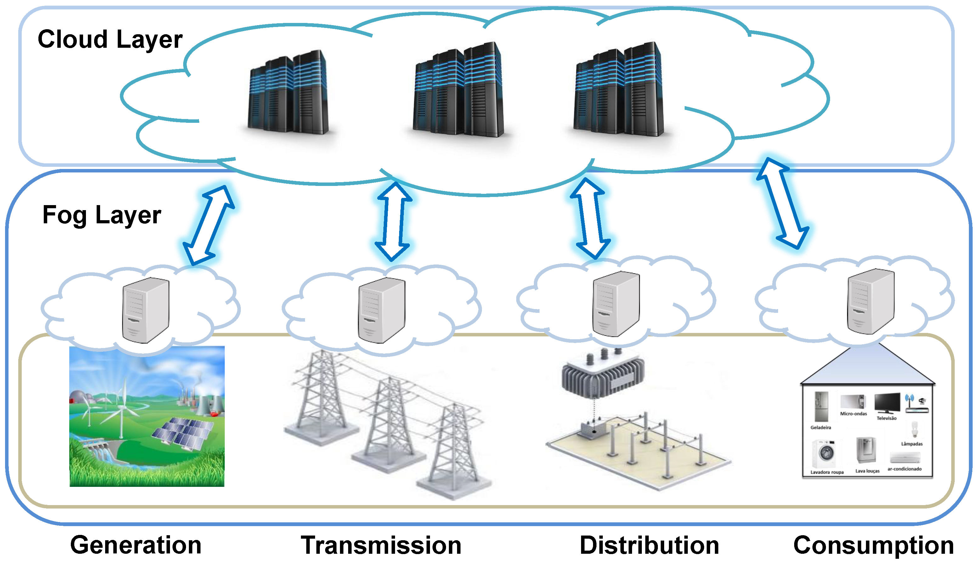
Cloud-to-Fog-to-Internet of Things (C2F2T) – Analytical Model 3
Proposes a strategy using fog computing with microgrids to reduce energy consumption of IoT applications.

Slide 30

Cloud-to-Fog-to-Internet of Things (C2F2T) – Analytical Model 3
Proposes a strategy using fog computing with microgrids to reduce energy consumption of IoT applications.
Equation specifically calculates the energy consumed by an IoT service using cloud computing.

Slide 31
Cloud-to-Fog-to-Internet of Things (C2F2T) – Analytical Model 3
E_{GW-r}: Energy consumed by IoT gateways when receiving data from IoT devices and sensors.
E_{GW-t}: Energy consumed by IoT gateways to transmit data to the cloud data center.
E_{net}: Energy consumed by the transport network between IoT gateways and the cloud.
E_{DC}: Energy consumed by components of the data center.

Slide 32
Cloud-to-Fog-to-Internet of Things (C2F2T) – Analytical Model 3
Equation calculates the energy consumption of communication between the IoT and the fog.

Slide 33
Cloud-to-Fog-to-Internet of Things (C2F2T) – Analytical Model 3
E_{GW-r}: Energy consumed by IoT gateways when receiving data from IoT devices and sensors.
E_{GW-t}: Energy consumed by IoT gateways to transmit data to the fog.
E_{net}: Energy consumed by the transport network between IoT gateways and the fog.
E_{DC}: Energy consumed by components of the fog.
E_{GW-c}: Energy consumed by IoT gateways for local computation and processing.
𝛽: Ratio of the number of updates from the fog to the cloud for synchronization.

Slide 34
Cloud-to-Fog-to-Internet of Things (C2F2T) – Analytical Model 4
Proposes an analytical modelling approach to estimate the reliability of an IoT scenario in a smart home context.
The algorithm estimates the reliability of the IoT service, which consists of n subsystems.
The calculation considers three factors:
Availability of programs (Ppr): Availability of all k programs running on virtual machines.
Availability of input files (Pf): Availability of f input files for the programs.
Reliability of each subsystem (ISR): Reliability of each virtual machine being executed.

Slide 35

Cloud-to-Fog-to-Internet of Things (C2F2T) – Analytical Model 4

Slide 36
Cloud-to-Fog-to-Internet of Things (C2F2T) – Other Analytical Model
Model Name | Purpose | Use case | Calculated
Fuzzy Ontology | Fault classification in WSNs; Handles uncertainty in sensor data; Improves fault diagnosis accuracy. | Fault types in WSNs, their relationships, and membership degrees. | Degree of membership of a sensor reading to different fault types; Most probable fault type.
Bayesian Probability | Predicting future events in IoT applications; Handling uncertainty in predictions; Incorporating prior knowledge and updating with new data. | Occurrence of future events in IoT systems (e.g., flight delays, equipment failures). | Probabilities of future events; Likelihood of chain events occurring.
Markov Chains | Modeling energy consumption in IoT devices; Predicting energy consumption patterns; Optimizing energy usage. | Device states (e.g., active, idle, sleep), state transitions, and energy consumption in each state. | Long-term energy consumption of devices; Optimal energy-saving strategies.

Slide 37
Cloud-to-Fog-to-Internet of Things (C2F2T) – Other Analytical Model
Model Name | Purpose | Use case | Calculated
Integer Linear Programming (ILP) & Mixed-Integer Linear Programming (MILP) | Minimizing cost in IoT and cloud computing; Optimizing resource allocation, task scheduling, and network design. | Resource allocation, task scheduling, network design, and other optimization problems. | Optimal resource allocation, task schedules, network configurations to minimize cost.
Petri Nets | Modeling and analyzing the dynamics of C2F2T systems; Representing data flow, task execution, resource allocation, and synchronization; Verifying system correctness and performance. | Data flow, task execution, resource allocation, and synchronization in C2F2T systems. | System performance metrics (e.g., throughput, latency, resource utilization); Potential bottlenecks; System correctness and reliability.

Slide 38
Cloud-to-Fog-to-Internet of Things (C2F2T) – Other Analytical Model
Presents a model to evaluate the security level of C2T systems, focusing on the flow of information and system states.
Uses a knapsack problem (MKP) to optimize service allocation in C2F2T scenarios, considering load balancing, delay, and energy consumption.
Formulates an optimization problem to maximize cloud service utilities and obtain optimal payment and computation offloading.

Slide 39
Cloud-to-Fog-to-Internet of Things (C2F2T) – Other Analytical Model
Proposes analytical modeling to represent QoS of IoT composite services and optimize cost with QoS constraints.
Uses analytical models to decide whether computing should be offloaded to IoT devices or the cloud, considering QoS and energy levels.
Compares the performance of fog architecture against traditional cloud computing using analytical models.
Present analytical models to represent mobile nodes connected to cloud computing, considering device movement and architecture components

Slide 40
Cloud-to-Fog-to-Internet of Things (C2F2T) – Petri Net Models
A powerful model for representing and analyzing systems (performance, dependability).
Offer flexibility in modeling (Markovian and non-Markovian distributions).
Can represent systems with fewer states compared to Markov chains.

Slide 41
Cloud-to-Fog-to-Internet of Things (C2F2T) – Petri Net Models
Petri nets are a powerful formalism for modeling concurrent systems
Mobile Devices: Each mobile device can be represented as a place in the Petri net. Tokens in the place indicate the availability of the device for sensing and data transmission.
Sensing Tasks: Sensing tasks, such as collecting location data, measuring temperature, or capturing images, can be modeled as transitions.
Data Flow: The movement of data from the mobile devices to the central server or processing unit can be represented by directed arcs connecting places and transitions.
User Interactions: User actions, such as initiating a sensing task, approving data sharing, or providing feedback, can be modeled as transitions.
System States: Different states of the MCS system, such as idle, active sensing, data transmission, and data processing, can be represented by different markings of the Petri net (i.e., the distribution of tokens in the places).

Slide 42
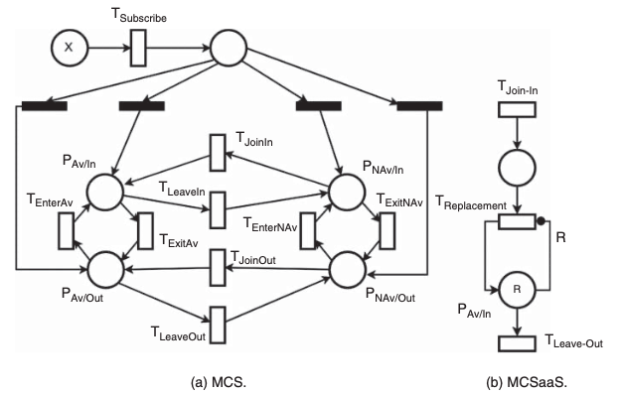
Cloud-to-Fog-to-Internet of Things (C2F2T) – Petri Net Models
Circle - the state or condition of the system
Rectangle - model events or actions that cause state changes.
Arcs - indicate the flow of tokens

Slide 43
Cloud-to-Fog-to-Internet of Things (C2F2T) – Petri Net Models
Investigated a mobile crowdsensing framework.
Used Petri Nets to compare the proposed framework with standard architectures.
Modeled node states (availability, position) and transitions between them.
Highlighted the complexity of the proposed framework due to added modules.

Slide 44
Cloud-to-Fog-to-Internet of Things (C2F2T) – Petri Net Models
Focused on data traceability in a C2T (Continuous Care and Treatment) scenario.
Employed a Petri Net to map and match device data to users.
Used the Petri Net to represent the behavior of a wearable IoT architecture.
Modeled data sources and events (e.g., new medical data readings).

Slide 45
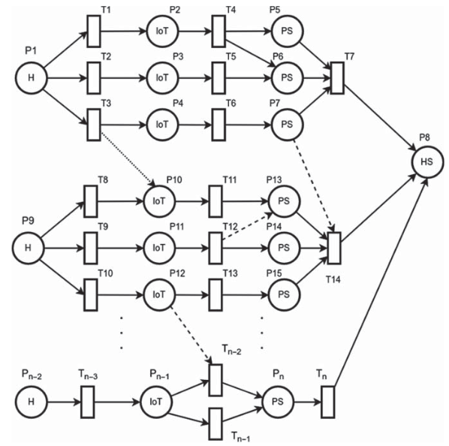
Cloud-to-Fog-to-Internet of Things (C2F2T) – Petri Net Models

Slide 46
Cloud-to-Fog-to-Internet of Things (C2F2T) – Integer Linear Programming
A method for solving optimization problems where all variables are integers.
Objective function and constraints are linear.
Mixed-Integer Linear Programming (MILP):
An extension of ILP that allows both continuous and integer variables.

Slide 47
Cloud-to-Fog-to-Internet of Things (C2F2T) – Integer Linear Programming
Used Integer Linear Programming (ILP) to minimize the financial cost of a fog-cloud architecture in a MAN.
Considered costs related to processing, storage, upstream/downstream traffic, and network capacity.
Represented application profiles and node characteristics as vectors.

Slide 48
Cloud-to-Fog-to-Internet of Things (C2F2T) – Integer Linear Programming
Employed MILP to minimize energy consumption in an IoT architecture with mini-clouds.
Considered traffic-induced and processing-induced energy consumption.

Slide 49
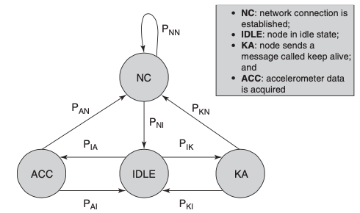
Cloud-to-Fog-to-Internet of Things (C2F2T) – Other Approaches
Markov Chains:
Model sequences of events where the current state depends only on the previous state.
Used in [21] to model energy consumption in an IoT-based collision detection system.
Energy consumption is estimated by calculating the probability of each system state.

Slide 50
Cloud-to-Fog-to-Internet of Things (C2F2T) – Other Approaches
Bayesian Probability:
Represents the probability of an event considering prior knowledge and available information.
Used in [24] to predict future events in IoT applications.
Focuses on calculating conditional probabilities of events.
Fuzzy-Ontology:
Combines ontology (for describing system components and their relationships) with fuzzy logic (for handling uncertainty and imprecision).
Used in [17] to analyze faults in WSN scenarios.
Provides a flexible framework for detecting and categorizing faults from different perspectives.

Slide 51
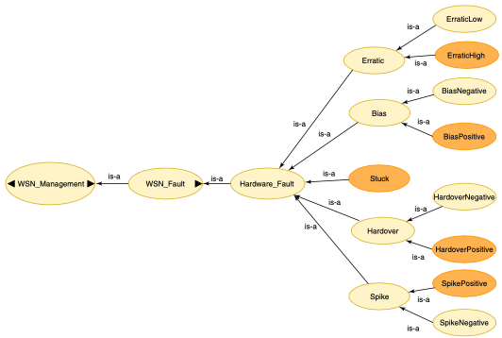
Cloud-to-Fog-to-Internet of Things (C2F2T) – Other Approaches

Slide 52
Integrated C2F2T Literature by Modeling Technique
Modelling Technique | Use Case Scenario | Application | Metrics | Key Findings/Objectives
Analytical Model | Resource Management | Energy Consumption of Devices in Cloud-IoT Context | Energy Consumption | Analyze the relationship between energy consumption of IoT devices and cloud billing costs.
Analytical Model | Resource Management | Energy Efficiency of IoT Devices | Energy Consumption | Improve energy efficiency of IoT devices.
Analytical Model | Resource Management | Energy Consumption of WSN | Energy Consumption | Analyze energy consumption in a WSN.
Analytical Model | Resource Management | Energy Consumption in Fog-IoT Integration | Energy Consumption | Reduce energy consumption by integrating IoT and fog computing.
Analytical Model | Resource Management | Resource Allocation in C2F2T | Energy Consumption, Resource Usage | Optimize resource allocation considering energy consumption, processing capacity, and overall service allocation.
Analytical Model | Resource Management | QoS in IoT and Cloud-IoT | Response Time, Reliability, Availability | Calculate QoS of IoT services and predict QoS for IoT and cloud services.

Slide 53
Integrated C2F2T Literature by Modeling Technique
Modelling Technique | Use Case Scenario | Application | Metrics | Key Findings/Objectives
Analytical Model | Smart Cities | Air Quality Sensing with Mobile Devices | Energy Consumption, Percentage Energy Saved | Model energy consumption in a mobile crowdsensing application.
Analytical Model | Smart Cities | Vehicle-to-Cloud Monitoring | QoS (Object Detection Accuracy), Energy Consumption | Determine optimal processing location (edge or cloud) for video data.
Analytical Model | Smart Cities | Smart Living Spaces with Cloud Access | Scheduling Performance (Scalability, Waiting Time, Throughput) | Develop a scheduling model for managing sensor applications in a smart living space.
Analytical Model | Smart Cities | Fire Alarm System | Reliability | Evaluate the reliability of a fire alarm system in an IoT context.
Analytical Model | Wireless Sensor Networks (WSN) | Fault Tolerance | Packet Delivery Latency | Model a WSN for sensing as a service integrated with IoT and cloud.
Analytical Model | Health | Health Monitoring | - | Develop a framework for sharing IoT devices in health monitoring.

Slide 54
Integrated C2F2T Literature by Modeling Technique
Modelling Technique | Use Case Scenario | Application | Metrics | Key Findings/Objectives
Analytical Model | Health | Medical Research | Security (Opacity) | Analyze security of information flow in cloud-integrated IoT systems.
Analytical Model | Generic IoT/Fog/Cloud | Three-tier C2F2T Model | Energy Consumption, Latency | Represent a generic C2F2T architecture and analyze energy consumption and latency.
Analytical Model | Generic IoT/Fog/Cloud | Fog Computing for Improved Response Time | Effective Arrival Rate, Average System Response, Average Buffer Occupancy | Improve response time of IoT systems using fog computing.
Analytical Model | Generic IoT/Fog/Cloud | Generic Fog Architecture | Energy Consumption, Latency | Compare performance of fog architecture against traditional cloud computing.
Analytical Model | Generic IoT/Fog/Cloud | Edge Offloading | Resource Consumption (Cloud and IoT Device Consumption) | Improve mobile user experience by offloading computation to the edge.
Petri Net | Smart Cities | Crowdsensing in Smart Traffic | System Effectiveness | Evaluate a mobile crowdsensing-as-a-service architecture.

Slide 55
Integrated C2F2T Literature by Modeling Technique
Modelling Technique | Use Case Scenario | Application | Metrics | Key Findings/Objectives
Petri Net | Health | Wearable IoT for Healthcare | Reliability | Manage traceability of data in a wearable IoT architecture.
Integer Linear Programming (ILP) | Resource Management | Resource Allocation in C2F2T | Energy Consumption, Resource Usage | Optimize resource allocation considering energy consumption, processing capacity, and overall service allocation.
Other Approaches | Smart Cities | Airplane Monitoring | - | Predict flight delays based on equipment data.
Other Approaches | Wireless Sensor Networks (WSN) | Fault Tolerance | - | Verify fault tolerance in large-scale WSN using service-oriented applications.

Slide 56
Cloud-to-Fog-to-Internet of Things (C2F2T) – By Use case Scenarios
Health:
Security of information flow in medical applications
Sharing IoT devices for health monitoring
Wearable IoT architecture for healthcare
WSN:
Fault tolerance in large-scale WSNs
WSN model for sensing as a service

Slide 57
Cloud-to-Fog-to-Internet of Things (C2F2T) – By Use case Scenarios
Smart Cities:
Mobile crowdsensing for smart traffic
Air quality monitoring using mobile sensors
Vehicle-to-cloud monitoring with edge computing
Fire alarm system
Flight delay prediction
Smart living space scheduling
Resource Management:
Energy consumption of IoT devices
Resource allocation in C2F2T context
QoS in IoT and cloud-IoT environments

Slide 58
Cloud-to-Fog-to-Internet of Things (C2F2T) – By Use case Scenarios
Other/Generic:
General C2F2T architecture
Improving response time in IoT systems
Generic fog architecture
Offloading computing to the edge

Slide 59
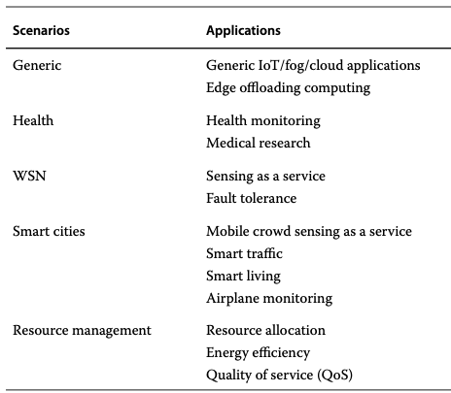
Cloud-to-Fog-to-Internet of Things (C2F2T) – By Use case Scenarios

Slide 60
Cloud-to-Fog-to-Internet of Things (C2F2T) – By Use case Scenarios
Use Case Scenario | Application | Modelling Technique | Metrics | Key Findings/Objectives
Resource Management | Energy Consumption of Devices in Cloud-IoT Context | Analytical Model | Energy Consumption | Analyze the relationship between energy consumption of IoT devices and cloud billing costs.
Resource Management | Energy Efficiency of IoT Devices | Analytical Model | Energy Consumption | Improve energy efficiency of IoT devices.
Resource Management | Energy Consumption of WSN | Analytical Model | Energy Consumption | Analyze energy consumption in a WSN.
Resource Management | Energy Consumption in Fog-IoT Integration | Analytical Model | Energy Consumption | Reduce energy consumption by integrating IoT and fog computing.
Resource Management | Resource Allocation in C2F2T | Analytical Model, Integer Linear Programming | Energy Consumption, Resource Usage | Optimize resource allocation considering energy consumption, processing capacity, and overall service allocation.
Resource Management | QoS in IoT and Cloud-IoT | Analytical Model | Response Time, Reliability, Availability | Calculate QoS of IoT services and predict QoS for IoT and cloud services.
Smart Cities | Crowdsensing in Smart Traffic | Petri Net | System Effectiveness | Evaluate a mobile crowdsensing-as-a-service architecture.

Slide 61
Cloud-to-Fog-to-Internet of Things (C2F2T) – By Use case Scenarios
Use Case Scenario | Application | Modelling Technique | Metrics | Key Findings/Objectives
Smart Cities | Air Quality Sensing with Mobile Devices | Analytical Model | Energy Consumption, Percentage Energy Saved | Model energy consumption in a mobile crowdsensing application.
Smart Cities | Vehicle-to-Cloud Monitoring | Analytical Model | QoS (Object Detection Accuracy), Energy Consumption | Determine optimal processing location (edge or cloud) for video data.
Smart Cities | Smart Living Spaces with Cloud Access | Analytical Model | Scheduling Performance (Scalability, Waiting Time, Throughput) | Develop a scheduling model for managing sensor applications in a smart living space.
Smart Cities | Fire Alarm System | Analytical Model | Reliability | Evaluate the reliability of a fire alarm system in an IoT context.
Smart Cities | Airplane Monitoring | Bayesian Model | - | Predict flight delays based on equipment data.
Wireless Sensor Networks (WSN) | Sensing as a Service | Fault Fuzzy-Ontology | - | Verify fault tolerance in large-scale WSN.
Wireless Sensor Networks (WSN) | Fault Tolerance | Analytical Model | Packet Delivery Latency | Model a WSN for sensing as a service integrated with IoT and cloud.

Slide 62
Cloud-to-Fog-to-Internet of Things (C2F2T) – By Use case Scenarios
Use Case Scenario | Application | Modelling Technique | Metrics | Key Findings/Objectives
Health | Health Monitoring | Analytical Model | - | Develop a framework for sharing IoT devices in health monitoring.
Health | Medical Research | Analytical Model | Security (Opacity) | Analyze security of information flow in cloud-integrated IoT systems.
Health | Wearable IoT for Healthcare | Petri Net | Reliability | Manage traceability of data in a wearable IoT architecture.
Generic IoT/Fog/Cloud | Three-tier C2F2T Model | Analytical Model | Energy Consumption, Latency | Represent a generic C2F2T architecture and analyze energy consumption and latency.
Generic IoT/Fog/Cloud | Fog Computing for Improved Response Time | Analytical Model | Effective Arrival Rate, Average System Response, Average Buffer Occupancy | Improve response time of IoT systems using fog computing.
Generic IoT/Fog/Cloud | Generic Fog Architecture | Analytical Model | Energy Consumption, Latency | Compare performance of fog architecture against traditional cloud computing.
Generic IoT/Fog/Cloud | Edge Offloading | Analytical Model | Resource Consumption (Cloud and IoT Device Consumption) | Improve mobile user experience by offloading computation to the edge.

Slide 63
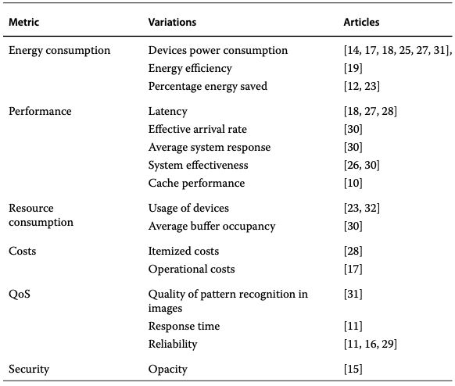
Cloud-to-Fog-to-Internet of Things (C2F2T) – By Metrics

Slide 64
Cloud-to-Fog-to-Internet of Things (C2F2T) – By Metrics
Metric | Use Case Scenario | Application | Modeling Technique | Key Findings/Objectives
Energy Consumption | Resource Management | Energy Consumption of Devices in Cloud-IoT Context | Analytical Model | Analyze the relationship between energy consumption of IoT devices and cloud billing costs.
Energy Consumption | Resource Management | Energy Efficiency of IoT Devices | Analytical Model | Improve energy efficiency of IoT devices.
Energy Consumption | Resource Management | Energy Consumption of WSN | Analytical Model | Analyze energy consumption in a WSN.
Energy Consumption | Resource Management | Energy Consumption in Fog-IoT Integration | Analytical Model | Reduce energy consumption by integrating IoT and fog computing.
Energy Consumption | Resource Management | Resource Allocation in C2F2T | Analytical Model, Integer Linear Programming | Optimize resource allocation considering energy consumption, processing capacity, and overall service allocation.
Energy Consumption | Smart Cities | Air Quality Sensing with Mobile Devices | Analytical Model | Model energy consumption in a mobile crowdsensing application.

Slide 65
Cloud-to-Fog-to-Internet of Things (C2F2T) – By Metrics
Metric | Use Case Scenario | Application | Modeling Technique | Key Findings/Objectives
Energy Consumption | Smart Cities | Vehicle-to-Cloud Monitoring | Analytical Model | Determine optimal processing location (edge or cloud) for video data.
Energy Consumption | Generic IoT/Fog/Cloud | Three-tier C2F2T Model | Analytical Model | Represent a generic C2F2T architecture and analyze energy consumption.
Energy Consumption | Generic IoT/Fog/Cloud | Generic Fog Architecture | Analytical Model | Compare performance of fog architecture against traditional cloud computing.
Performance | Resource Management | QoS in IoT and Cloud-IoT | Analytical Model | Calculate QoS of IoT services and predict QoS for IoT and cloud services.
Performance | Smart Cities | Crowdsensing in Smart Traffic | Petri Net | Evaluate a mobile crowdsensing-as-a-service architecture.
Performance | Smart Cities | Smart Living Spaces with Cloud Access | Analytical Model | Develop a scheduling model for managing sensor applications in a smart living space.

Slide 66
Cloud-to-Fog-to-Internet of Things (C2F2T) – By Metrics
Metric | Use Case Scenario | Application | Modeling Technique | Key Findings/Objectives
Performance | Generic IoT/Fog/Cloud | Fog Computing for Improved Response Time | Analytical Model | Improve response time of IoT systems using fog computing.
Resource Consumption | Resource Management | Resource Allocation in C2F2T | Analytical Model, Integer Linear Programming | Optimize resource allocation considering energy consumption, processing capacity, and overall service allocation.
Resource Consumption | Generic IoT/Fog/Cloud | Edge Offloading | Analytical Model | Improve mobile user experience by offloading computation to the edge.
Cost | Resource Management | Energy Consumption of Devices in Cloud-IoT Context | Analytical Model | Analyze the relationship between energy consumption of IoT devices and cloud billing costs.
QoS | Resource Management | QoS in IoT and Cloud-IoT | Analytical Model | Calculate QoS of IoT services and predict QoS for IoT and cloud services.
QoS | Smart Cities | Vehicle-to-Cloud Monitoring | Analytical Model | Determine optimal processing location (edge or cloud) for video data.

Slide 67
Cloud-to-Fog-to-Internet of Things (C2F2T) – By Metrics
Metric | Use Case Scenario | Application | Modeling Technique | Key Findings/Objectives
QoS | Smart Cities | Fire Alarm System | Analytical Model | Evaluate the reliability of a fire alarm system in an IoT context.
QoS | Health | Wearable IoT for Healthcare | Petri Net | Manage traceability of data in a wearable IoT architecture.
Security | Health | Medical Research | Analytical Model | Analyse security of information flow in cloud-integrated IoT systems.

Slide 68
Cloud-to-Fog-to-Internet of Things (C2F2T) – By Metrics - Energy consumption
Energy consumption is a major concern in C2F2T systems.
Factors influencing energy consumption:
Device modes: Active, idle, transitions between states
Communication: Data transmission, reception, listening, sensing
Distance and medium: Communication distance and environment
Traffic: Data traffic between layers
Processing: Processing-induced energy consumption by VMs
Device movement: Mobility of devices
Synchronization: Synchronization between IoT devices, fog, and cloud
Data flow: Application data flow patterns
Power sources: Renewable energy sources like solar power

Slide 69
Cloud-to-Fog-to-Internet of Things (C2F2T) – By Metrics - Performance
Latency:
Processing latency: Time taken for application tasks
Transmission latency: Communication delay for data transfer.
Packet delivery latency: Influenced by factors like hops, sleep intervals, and transmission time.
Request processing delay: Influenced by device computational complexity and application flow size.

Slide 70
Cloud-to-Fog-to-Internet of Things (C2F2T) – By Metrics - Performance
Other Performance Metrics:
Scalability: Ability to handle increasing numbers of devices and data
Waiting time: Average time for applications to be processed
Throughput: Number of applications processed successfully within a given time
Response time: Time elapsed from data generation to processing by a gateway
Processing efficiency: Considers processing time, buffer occupancy, and gateway response times

Slide 71
Cloud-to-Fog-to-Internet of Things (C2F2T) – By Metrics - Performance
Evaluation Methods
Analytical models: Mathematical models to analyze latency, delay, and processing efficiency
Simulation: Simulating system behavior to evaluate performance under different conditions
Petri Nets: Modeling system behavior and evaluating performance through state transitions

Slide 72
Cloud-to-Fog-to-Internet of Things (C2F2T) – By Metrics – Resource Consumption
Careful consideration of where workloads should be processed.
Focuses on optimizing service allocation in C2F2T infrastructures. It considers device resources and evaluates the advantages of fog computing.
Assesses resource consumption in C2T scenarios. This includes both cloud infrastructure and IoT device consumption.
IoT devices have limited computing and storage capacity.
Evaluates the effectiveness of gateways by examining buffer occupancy. It models data arrival at gateways as a queuing system.

Slide 73
Cloud-to-Fog-to-Internet of Things (C2F2T) – By Metrics - Cost
Cloud-heavy applications significantly increase costs for both providers and consumers.
Cost studies often overlap with energy consumption studies.
Investigated billing costs associated with reserved computational resources for IoT queries. Billing costs are directly linked to the volume of queries generated by IoT devices.
To minimize the operational cost of routing IoT traffic to the cloud. This includes costs associated with processing, storage, upstream/downstream traffic, local/global traffic, and link capacity.

Slide 74
Cloud-to-Fog-to-Internet of Things (C2F2T) – By Metrics – Quality of Service
QoS is significantly impacted by various factors:
Network delays
Available computational resources
Number of IoT devices consuming resources
Evaluating QoS for composite services:
Breaking down composite services into smaller, more granular services for individual QoS evaluation.

Slide 75
Cloud-to-Fog-to-Internet of Things (C2F2T) – By Metrics – Quality of Service
QoS in video streaming applications:
Analyzes video streams from vehicles, defining QoS as the accuracy of object detection in video images.
Varying video resolution impacts CPU, memory, and bandwidth consumption.
Accuracy is defined as the probability of a detection result exceeding a certain threshold among multiple results.

Slide 76
Cloud-to-Fog-to-Internet of Things (C2F2T) – By Metrics – Quality of Service
Reliability as a key aspect of QoS:
Emphasizes the importance of factors like service availability, input file availability, and reliability of individual subsystems for overall IoT system reliability.
Defines reliability in the context of security, specifically the ability of the traceability model to detect and prevent attacks.

Slide 77
Cloud-to-Fog-to-Internet of Things (C2F2T) – By Metrics – Quality of Service
Security is addressed in only one of the mentioned articles ([15]).
focuses on "opacity" in data flow within the C2T context.
Opacity is a uniform approach for defining security properties as predicates.
Analytical models are used to verify opacity in a medical research application scenario.

